Slide 1
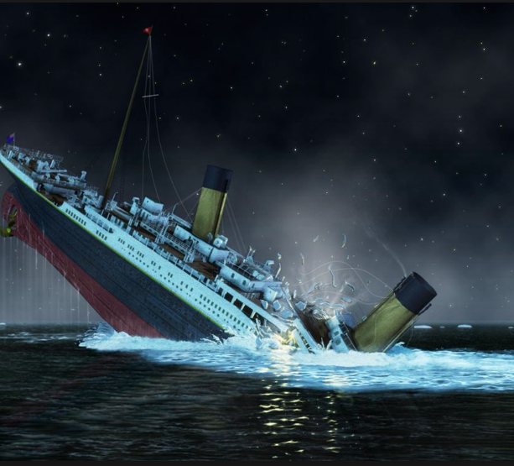
Titanic: Machine Learning from Disaster
Team:
Divjyot Khanuja
Neha Parakh
Sunil Kumar Mummadi
Yugeshwari Brahmankar
Vinit Kumar Singh

Slide 2



GOAL:To predict if a passenger survived the sinking of the Titanic or not
Shipwreck killed 1502 out of 2224 passengers and crew
Some groups of people were more likely to survive than others, such as women, children, and the upper-class
The challenge is to complete the analysis of what sorts of people were likely to survive and to apply the tools of machine learning to predict which passengers survived the tragedy

Slide 3
Features
Survived: Survived (1) or died (0)
Pclass: Passenger's class
Name: Passenger's name
Sex: Passenger's sex
Age: Passenger's age
SibSp: Number of siblings/spouses aboard
Parch: Number of parents/children aboard
Ticket: Ticket number
Fare: Fare
Cabin: Cabin
Embarked: Port of embarkation

Slide 4
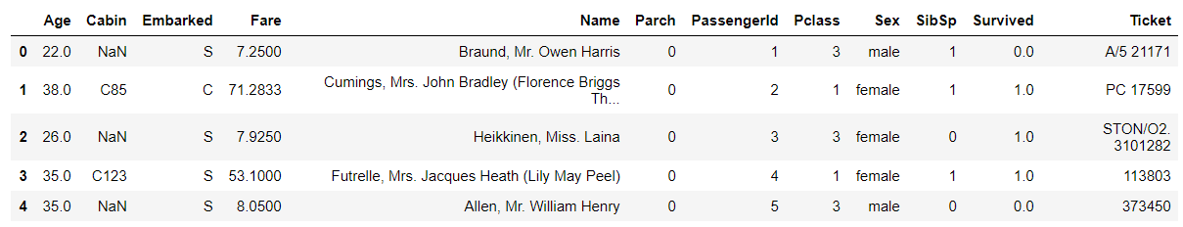
Sample of dataset
The head function displaying the first 5 rows.

Slide 5
Project Phase and Status
Selection of Data Set
Data Preprocessing
Data Exploration and Analysis
Visualization and Predictions
Phase 1
Phase 2
Phase 3
Phase 4
Studied and explored different dataset
Preprocessed few data sets
Analyzed the use cases that can fit in for given data set
Clean the data set
Preprocessed the price column
Dropped few columns
Feature Engineering and Data Enrichment, Data Mining and Feature Selection
Applied ML algos on the cleaned data
Recursive feature elimination with cross-validation
Explore feature that can be used
Performed a new approach by adding new optimal features to the dataset.
Compare results against previous ones
Activities
Selected Titanic NYC dataset
Reason
Huge data volume
Less preprocessing required
Preprocessing approaches
Selection of Implementation algorithm
Trained the model
Analysis of result
Seaborn used to Visualize the results and analysis
Plot the results using graph and charts
Outcomes

Slide 6
EXPLORATORY DATA ANALYSIS

Slide 7
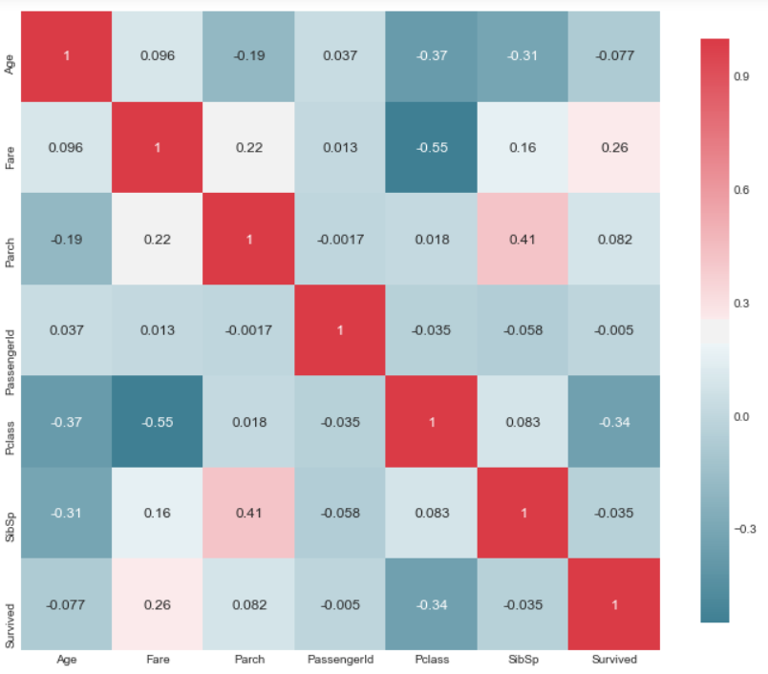
CORRELATION MAP
A heat map of correlation may give us a understanding of which variables are important

Slide 8
KDE plot
Distribution of Survivors categorized by gender and age

Slide 9
KDE plot
Distribution of Survivors categorized by gender and ticket fare.

Slide 10
Categorical distribution plot
Survival chances based on gender.
Survival based on passenger class.

Slide 11
DATA CLEANING

Slide 12
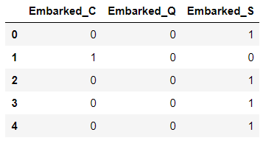
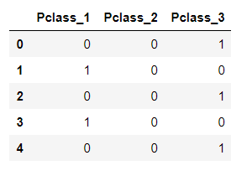
Categorical variables need to be transformed to numeric variables

Slide 13
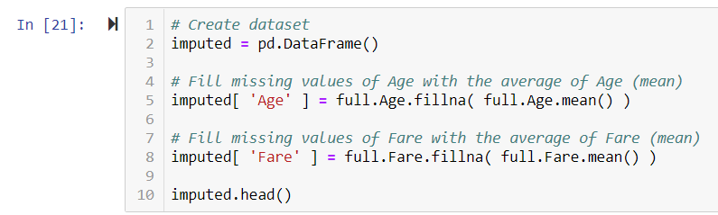
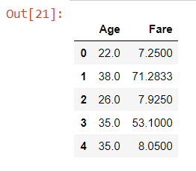
Fill missing values in variables

Slide 14
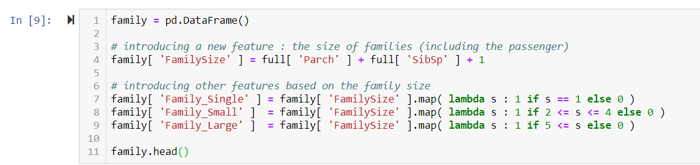
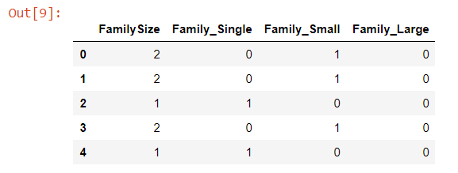
Feature Engineering – Creating new variables
Extract titles from passenger names
Extract Cabin category information from the Cabin number
Extract ticket class from ticket number
Create family size and category for family size
Fill missing values in variables

Slide 15
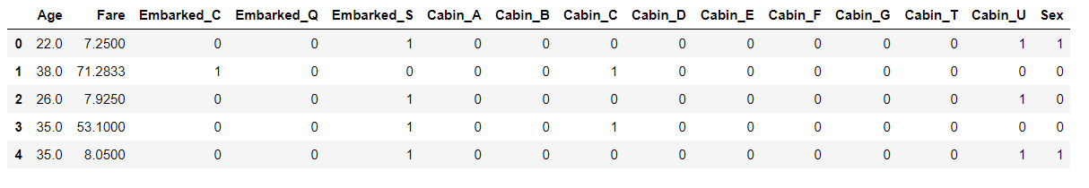
Putting it all together
Assemble final datasets for modelling

Slide 16
MODELLING

Slide 17
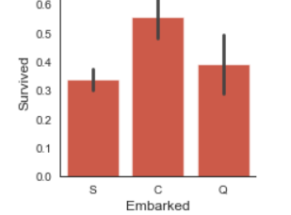
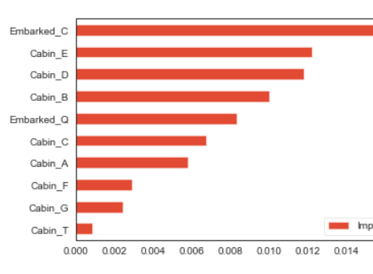
FEATURE IMPORTANCE
Evaluate what the most important variables are for the model to make the prediction.

Slide 18
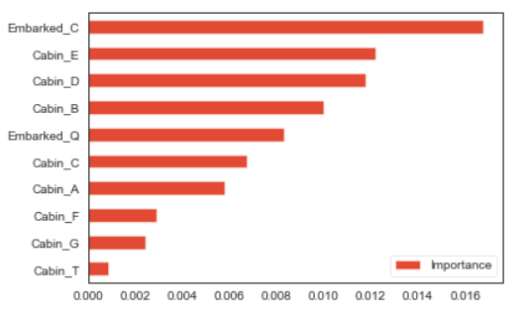
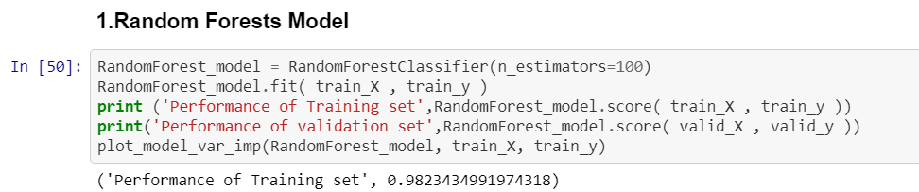
MODEL SELECTION AND RFECV
1.Random Forests Model
2.Support Vector Machines
3.Gradient Boosting Classifier
4.K-nearest neighbors
5.Gaussian Naive Bayes
6.Logistic Regression
7.Decision Tree

Slide 19
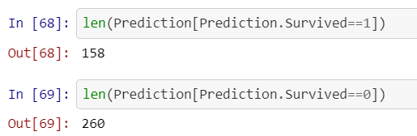
RESULT AND ANALYSIS
Used Random Forest classifier, giving us the final result as shown

Slide 20
A DIFFERENT APPROACH

Slide 21
DATA CLEANING AND FEATURE CHOOSING
Created 6 different dataframes to check how it affects the results differently

Slide 22
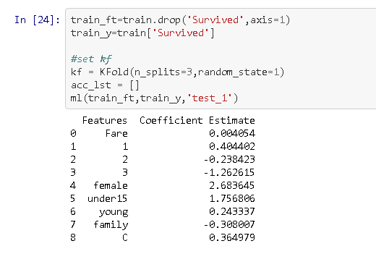
TEST DATAFRAMES
Test1- Used all the features
Test2-Dropped young age
Test3-Dropped young and Embark C
Test4-Dropped Fare
Test5-Dropped C
Test6-Dropped Fare and Young

Slide 23
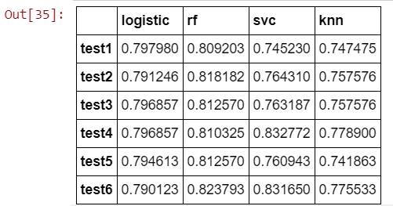
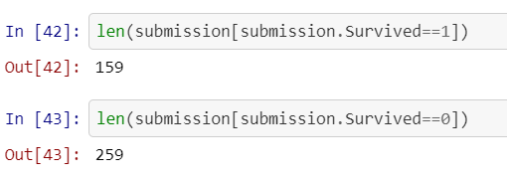
FINAL ANALYSIS

Slide 24
THANK YOU

